Slide 1

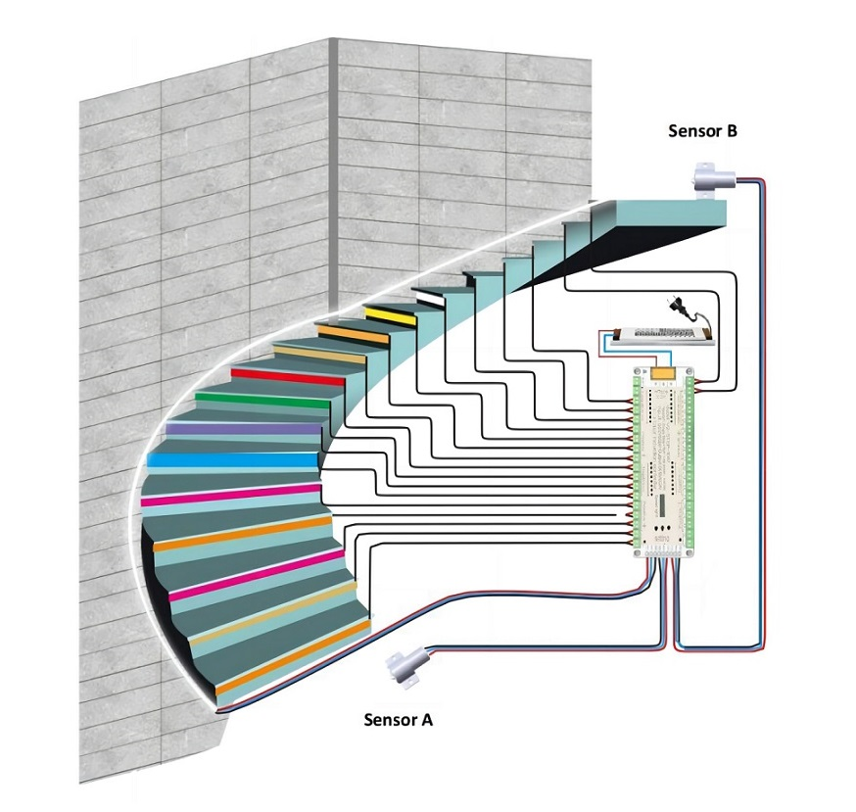
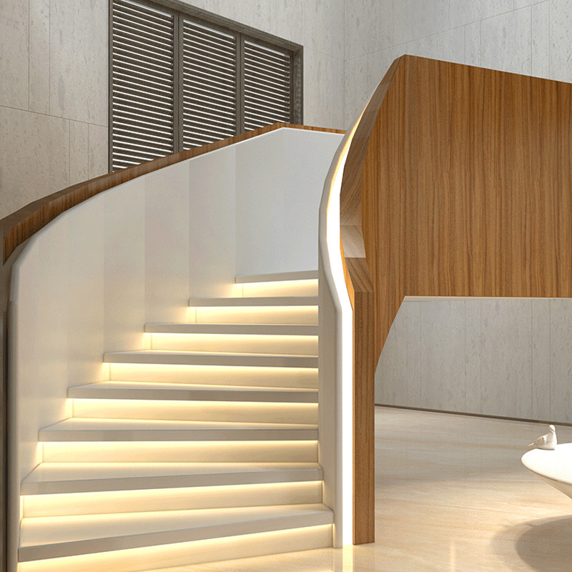
Instruction Manual For Motion Sensor LED Step Light
Installation Diagram

Slide 2
Installation notes
Connection method
Insert the LED strips into controller ports of the corresponding step in order.
In the 1 step, the positive of the LED strip is inserted into the number 1 of the orange terminal, and the negative is inserted into the number 1 of the green terminal;
In the 2 step, the positive of the LED strip is inserted into the number 2 of the orange terminal, and the negative pole is inserted into the number 2 of the green terminal;
In the 3 step, the positive of the LED strip is inserted into the number 3 of the orange terminal, and the negative pole is inserted into the number 3 of the green terminal;
Repeat until all LED Strips are connected...
The controller has 32 ports that can be used according to actual steps. Excess ports can be ignored and will not affect usage. If you want to add a light strip in the future, you can repeat the above steps.

Slide 3
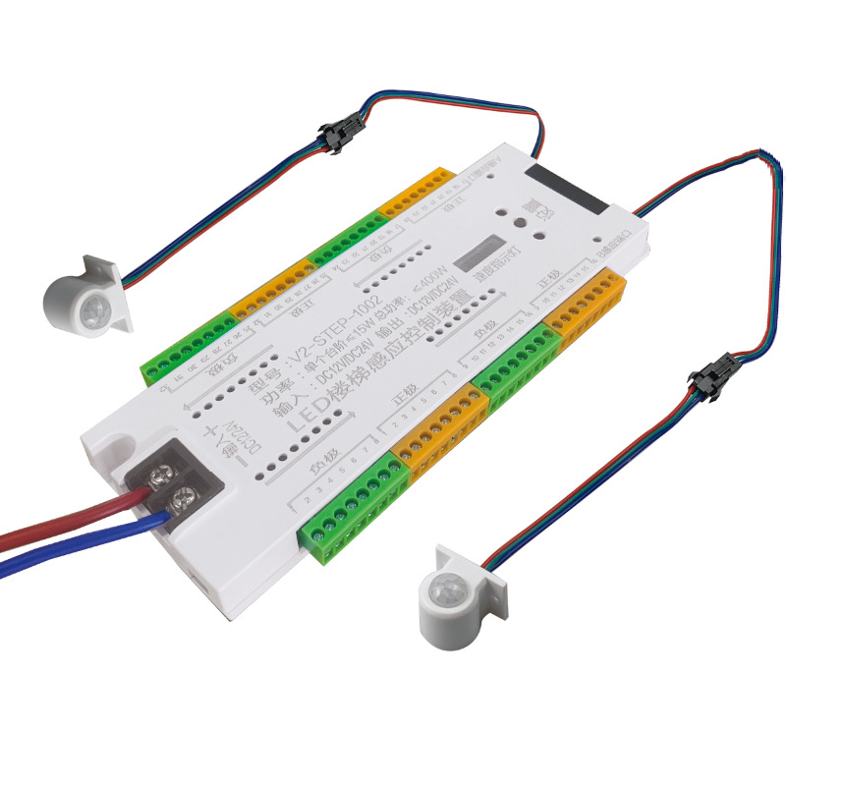
The package includes
one set including: controller, 2 x Sensors, 2x Extension Cables
Input voltage: DC 12V/24V
Output power: ≤400W MAX
Connection ports: 32pcs
Sensor: 2pcs (Sensor A & Sensor B)
Size: 185*85*20mm
Working mode: Light sense + human body sensing
(The light is on when people come, and off when people go.)

Slide 4
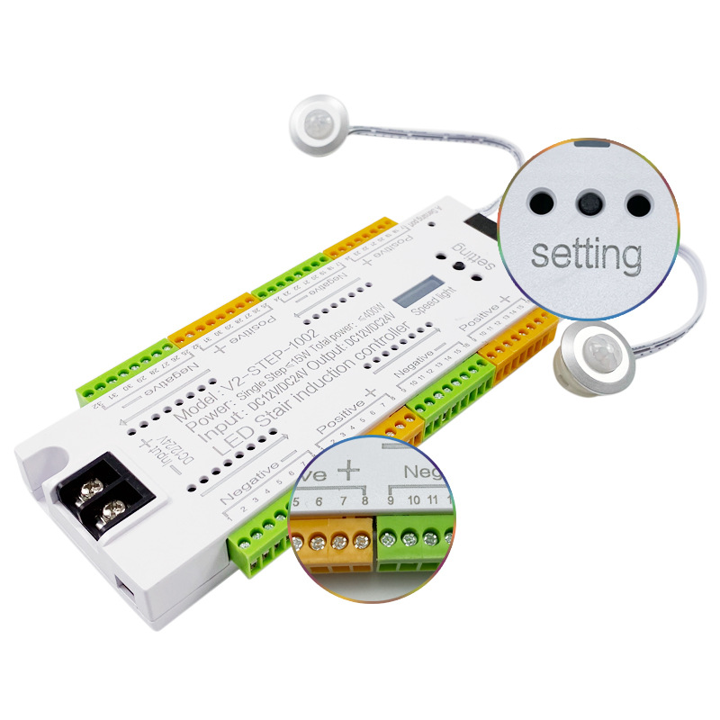
Operation Manual
Press the switch for a short time to adjust the LED speed. And the 4 gears can be adjusted, namely 100%, 75%, 50% and 25%,the darker the red light, the faster the speed, the brighter the red light, the slower the speed.
Press and hold the switch for 5 seconds to adjust the steps and lighting mode
Press the switch briefly once to set the first step, and the blue indicator on the controller lights up, indicating that the command is received;
Press the switch briefly once to set the second step. The blue indicator on the controller lights up, indicating that the command is received;
Press the switch briefly once to set the third step, and the blue indicator on the controller lights up, indicating that the command is received;
Repeat this operation until all light bars are set. After the operation is completed, press and hold again for 5 seconds to save automatically.

Slide 5
Points to note
This product is DC 12V/24V. Do not connect directly to 240v.
This product is only used in an indoor dry environment. Strong wind, high temperature, strong vibration and other adverse environments may cause sensor failure. The sensing angle is 120 ° and the sensing distance is 1-3m. The sensor is most sensitive to people.
The wires shall be arranged in order rather than twisted.
There is no special requirement for the installation position of the controller, which can be installed according to the reserved position.
Sensor A/B can be recessed or surface mounted installation.

